Slide 1

Vel Tech Rangarajan Dr. Sagunthala R&D Institute of Science and Technology
School of Computing
Department of Computer Science and Engineering
10211CS224 / FULL STACK APPLICATION DEVELOPMENT (JAVA)
PROJECT REVIEW : MILESTONE PROJECT – 2
Date: 20-04-2026
JOB PORTAL MANAGEMENT SYSTEM
SDG: SDG No – SDG 9 – Industry, Innovation and Infrastructure
Presented By:
Kurakula.Rajesh – VTU26466 – Reg.No.23UECS0300
Courses Handling Faculty:
Dr. Hafizur Rahman- B.E., M.Tech., Ph.D.

Slide 2
INTRODUCTION
• Managing job applications manually can lead to confusion, missed opportunities, and poor coordination between students and employers.
• In today’s digital world, connecting job seekers and employers efficiently is very important.
• This project aims to provide a simple and efficient Job Portal Management System.
• The system improves communication between students and employers through notifications and updates.
• It ensures a smooth and organized recruitment process.
• The application is built using Spring Boot, Thymeleaf, and MySQL.
• This project demonstrates real-world web application development, CRUD operations.
1
2
3
4
5
6
7
8
9

Slide 3
PROBLEM STATEMENT
• Manual handling of job applications often leads to confusion and miscommunication between students and employers.
• Job seekers may miss important job opportunities due to the absence of a centralized platform.
• Application processes are not well organized and can result in data loss or missed tracking.
• Job details are not easily accessible to all students in a structured way.
• Managing multiple job postings and applications manually becomes time-consuming for employers.
• Lack of proper communication regarding application status (shortlisted/rejected) affects user experience.
• No efficient system to update or delete job postings dynamically.
• Difficulty in tracking applied jobs and monitoring recruitment progress.
1
2
3
4
5
6
7
8
9

Slide 4
OBJECTIVE(S)
• To develop a Job Portal Management System for efficient recruitment and job application handling.
• To allow students to view all available job opportunities in a centralized platform.
• To enable students to apply for jobs easily through an online system.
• To provide a system for tracking application status (Applied, Shortlisted, Rejected).
• To allow employers to post, update, and delete job listings.
• To manage all user, job, and application data in a structured database.
• To improve communication between students and employers through notifications.
• To reduce manual work and streamline the hiring process.
• To build a real-time, user-friendly web application using modern technologies.
1
2
3
4
5
6
7
8
9

Slide 5
PROPOSED SYSTEM
1
• The proposed system is a web-based Job Portal Management System developed using Spring Boot, Thymeleaf, and MySQL.
• It allows students to view all available job opportunities and access job details in a centralized platform.
• Students can easily apply for jobs and track their application status through an online system.
• Employers can create, update, and delete job postings dynamically using the system.
• All user, job, and application data are securely stored in a MySQL database.
• The system provides a user-friendly interface for both students and employers.
• It reduces manual work involved in managing job applications and recruitment processes.
• It improves efficiency, transparency, and communication between students and employers.
2
3
4
5
6
7
8
9

Slide 6
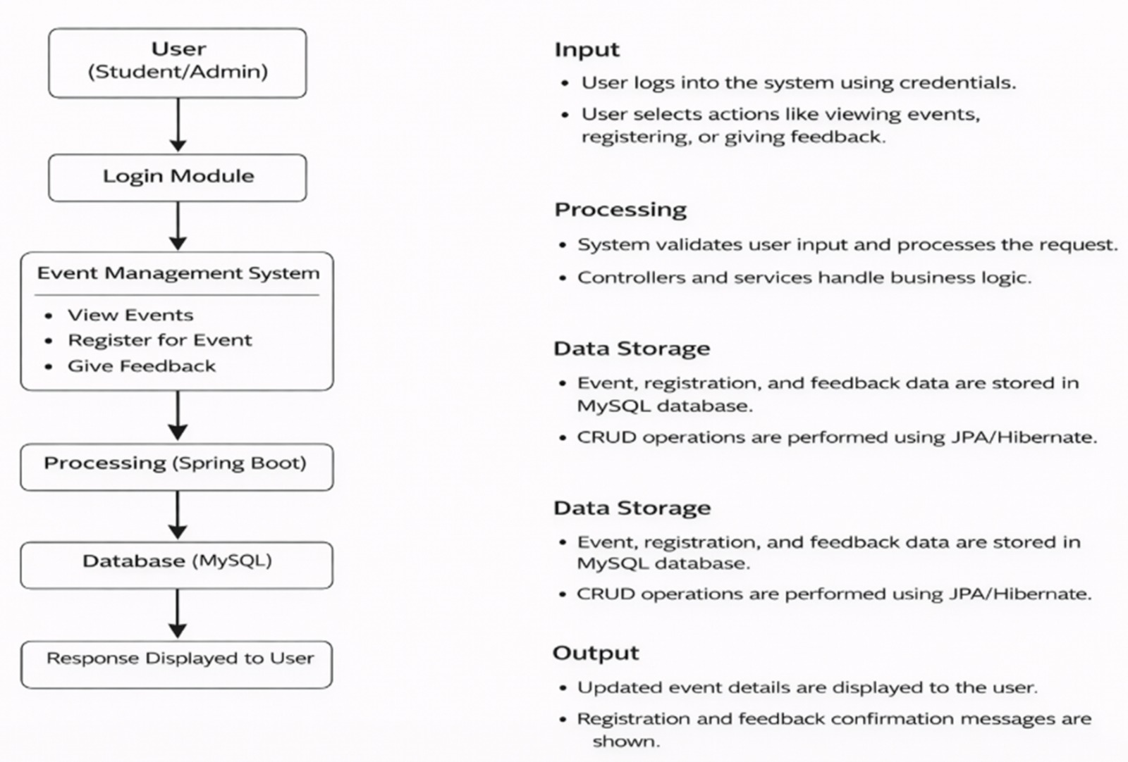
PROPOSED SYSTEM ARCHITECTURE
1
2
3
4
5
6
7
8
9

Slide 7
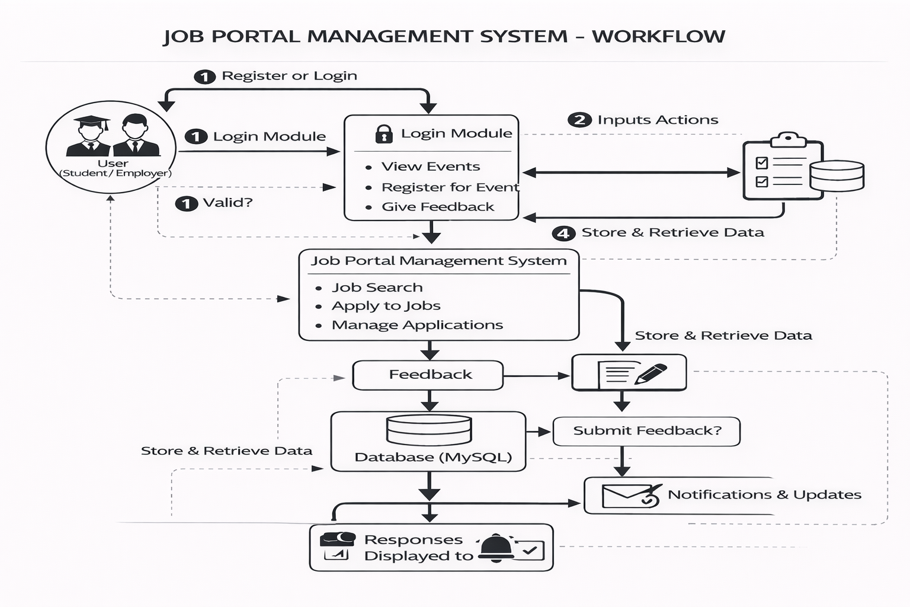
WORKFLOW
1
2
3
4
5
6
7
8
9

Slide 8
TECHNOLOGIES USED
Frontend:
HTML5
CSS3
Thymeleaf
Backend:
Spring Boot
Spring MVC
Spring Security
Database:
MySQL Workbench
Server:
Tomcat Server
Tools:
VS Code
MySQL Workbench
Web Browser (Chrome)
Postman (API Testing)
Hardware / Software Requirements:
System: Windows 10
RAM: Minimum 4GB
Software:
Java JDK(17 or above)
Apache Tomcat Server
MySQL Server
1
2
3
4
5
6
7
8
9

Slide 9
MODULE DESCRIPTION
1
Module 1: User Authentication Handles login and registration for Students and Employers using secure authentication. Restricts unauthorized access based on user roles (Student / Employer).
Module 2: Job Management (Employer Side) Allows employers to post new jobs with title, description, skills, salary, and location. Provides options to update and delete job postings using CRUD operations.
Module 3: Student Interaction Allows students to browse available jobs in the system. View detailed job information using web pages and APIs.
2
3
4
5
6
7
8
9

Slide 10
MODULE DESCRIPTION
1
Module 4: Job Application Management Students can apply for jobs through an online form. Students can view and track application status (Applied, Shortlisted, Rejected).
Module 5: Search & Filters Search jobs based on location, skills, and experience. Displays filtered results dynamically for better user experience.
Module 6: Notification System Sends email notifications to students when application status changes. Notifies employers when a new application is received.
2
3
4
5
6
7
8
9

Slide 11
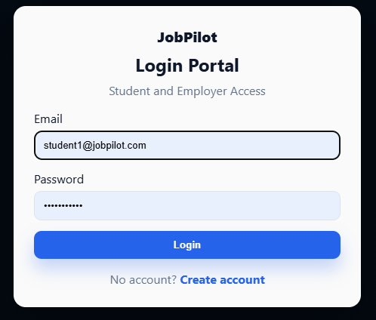
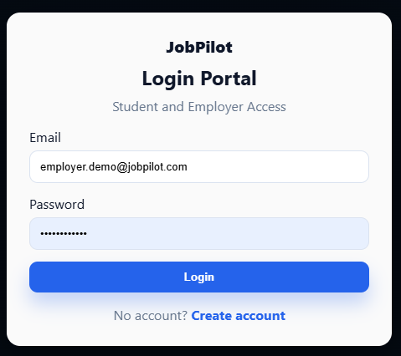
IMPLEMENTATION SCREENSHOTS
1
• The User Login module authenticates registered users using their username and password. • The system verifies the credentials from the database and grants access to the dashboard upon successful login. • If the credentials are incorrect, an error message is displayed to ensure secure access control.
2
3
4
5
6
7
8
9

Slide 12
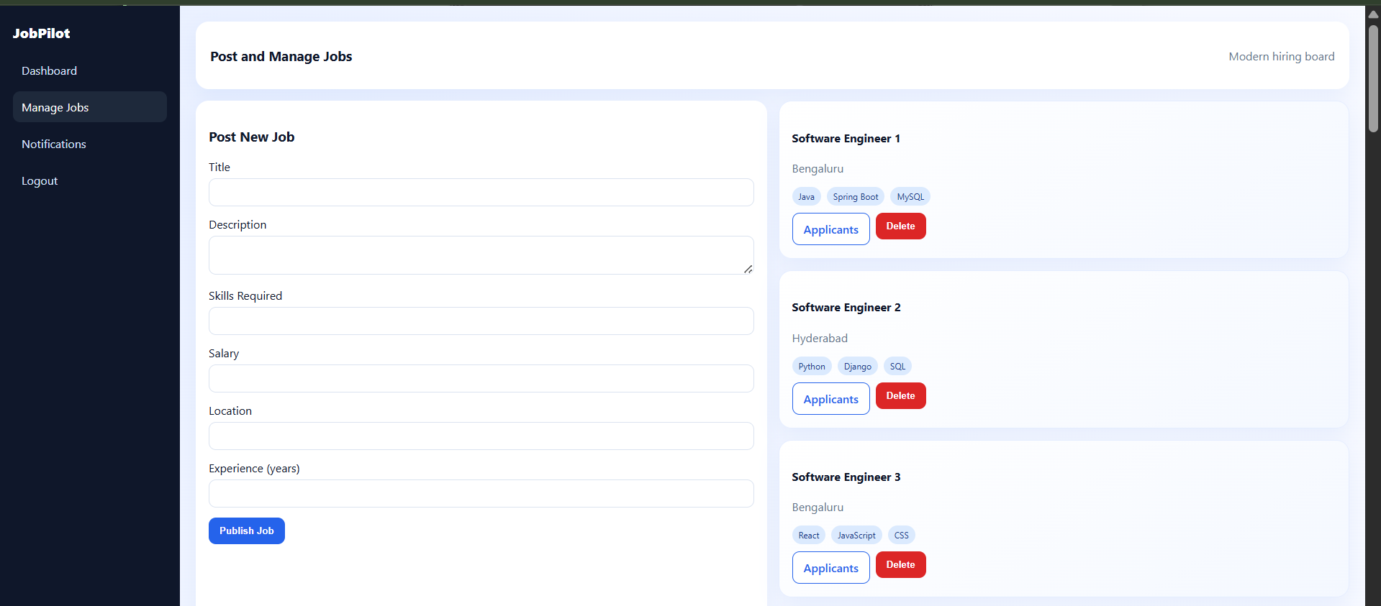
IMPLEMENTATION SCREENSHOTS
1
Shows a list of upcoming events with complete details such as ID, title, description, department, type, and date.
Provides a search bar to filter events based on department (e.g., CSE, IT) for quick access.
Allows admin actions like Edit and Delete, and student actions like Register for Event and Give Feedback.
2
3
4
5
6
7
8(A)
9

Slide 13
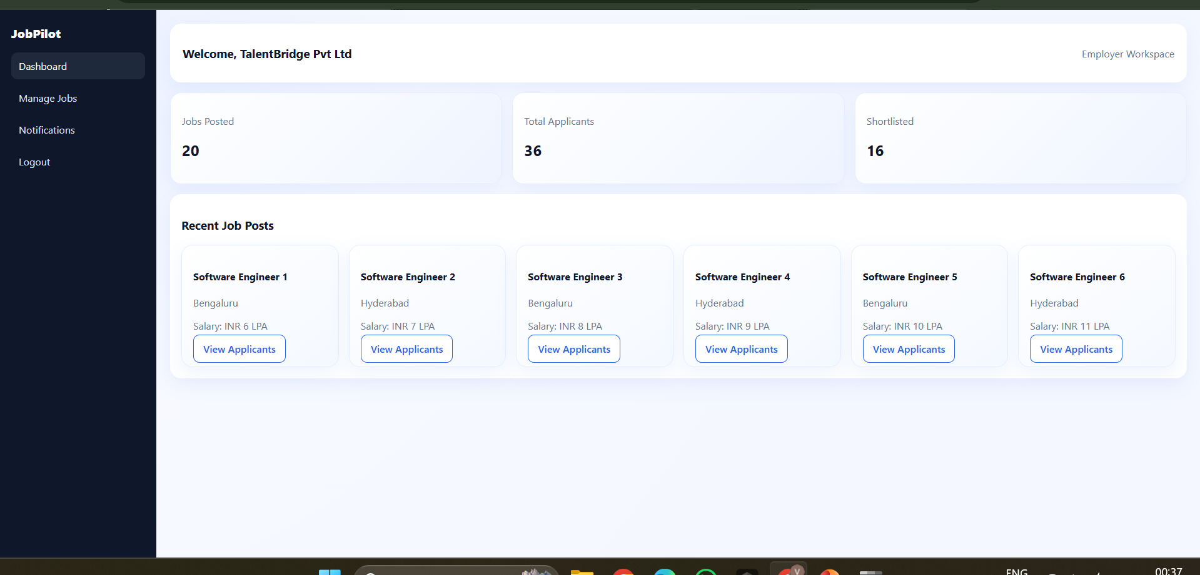
IMPLEMENTATION SCREENSHOTS
1
Allows admin to modify existing event details such as title, description, department, type, and date.
Pre-filled form fields display current event information for easy editing and updates.
Provides a single action button to submit and save the updated event details.
2
3
4
5
6
7
8(B)
9

Slide 14
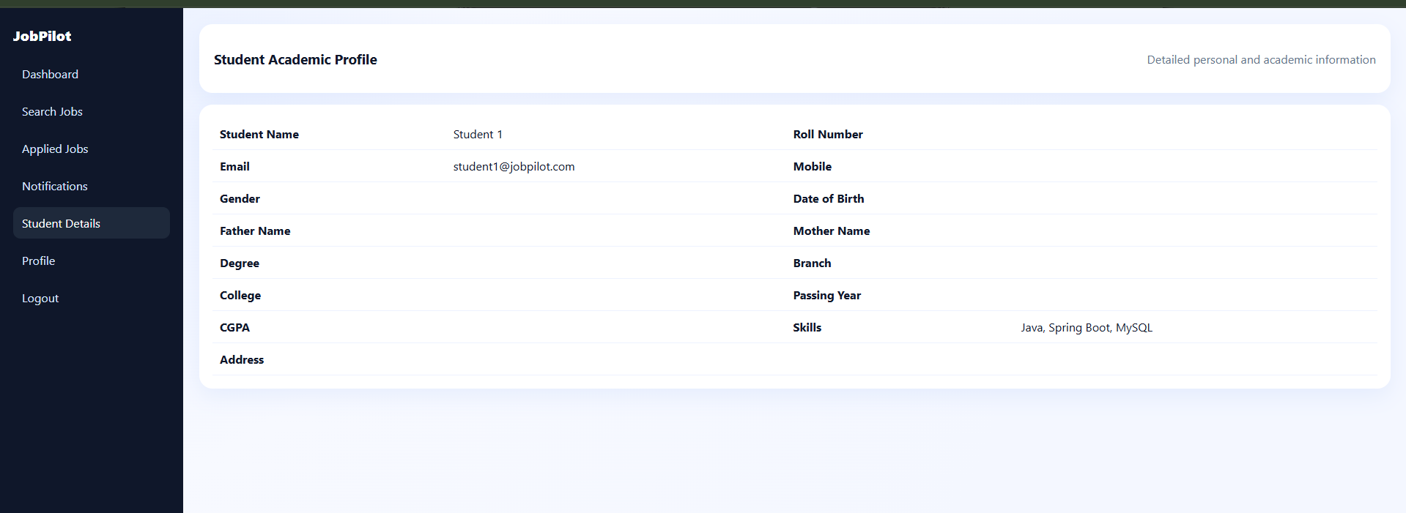
IMPLEMENTATION SCREENSHOTS
1
Allows students to submit feedback for a specific event by entering their name and event ID.
Provides a text area for users to write detailed feedback about their experience.
Includes a submission button to send and store feedback in the system.
2
3
4
5
6
7
8(C)
9

Slide 15
ADVANTAGES & LIMITATIONS
Advantages:
• Simple and user-friendly interface. • Supports CRUD operations for job and application management. • Role-based access for Students and Employers. • Centralized database for jobs and applications. • Easy job search with filters (location, skills, experience).
Limitations:
• Basic UI without advanced design. • Limited features (no advanced analytics). • Depends on local server setup. • No mobile application support. • Limited scalability for large users.
1
2
3
4
5
6
7
8
9

Slide 16
Thank you

